Slide 1
Integration of Neuroadaptive physiology module in Metachron
Imtiaj Ahmed, Michiel Spape, Ville Harjunen, Marie Al-Ghossein, Mikko Kytö,
Niklas Ravaja, Giulio Jacucci
University of Helsinki

Slide 2
Initial plan
Integrating neuroadaptive starfield demo environment to metachron.
Interfacing neuroadaptive module to control starfield in Metachron.
The work is demonstrating a neuroadaptive environment which can be extended to experiment with modulating subjective time and related distortions.
A new version of D5.1 Psychophysiological states detection from WP5
Notes:
This work considers WP5 lead by Helsinki.
Aim: to develop a solution for detecting psychophysiological states related to time perception and online converting the data to values that are used in manipulating the visual feedback presented in VR.
The work is geared towards demonstrating the usefulness of neuroadaptivity in modulating subjective time and related distortions

Slide 3
Overview of the neuroadaptive starfield demo environment
Current status?
How to use it?
Integration/Interface neuroadaptive module with metachron
Requirements?
How to?
Possible solutions?
Notes:
This work considers WP5 lead by Helsinki.
Aim: to develop a solution for detecting psychophysiological states related to time perception and online converting the data to values that are used in manipulating the visual feedback presented in VR.
The work is geared towards demonstrating the usefulness of neuroadaptivity in modulating subjective time and related distortions

Slide 4
Overview: Neuroadaptive starfield demo env
Participant/user controls speed of the stars by imagining running or walking.
Participant’s psychophysiological signals are trained and classified online to detect run and walk using machine learning algorithm.
Each time neuroadaptive module detects a run accelerate the stars movement and decelerate while walk detected.
Notes:
This work considers WP5 lead by Helsinki.
Aim: to develop a solution for detecting psychophysiological states related to time perception and online converting the data to values that are used in manipulating the visual feedback presented in VR.
The work is geared towards demonstrating the usefulness of neuroadaptivity in modulating subjective time and related distortions

Slide 5
Steps
Calibration
Participants instructed to imagine run/walk for a fixed period of time, say 10 seconds. A visual stimuli of walk/run is shown in the beginning of the said period and a stop (standing) stimuli at the end.
Openvibe scenarios (Machine learning algorithms) run in parallel to record and trained the psychophysilogical signals of imagined run/walk.
Online
Openvibe scenarios (Machine learning algorithms) runs to detect imagined run/walk from psychophysilogical signals and send classification results to the starfield environment.
Demo starfield environment receives data from the openvibe and updates the starfield speed.
Notes:
This work considers WP5 lead by Helsinki.
Aim: to develop a solution for detecting psychophysiological states related to time perception and online converting the data to values that are used in manipulating the visual feedback presented in VR.
The work is geared towards demonstrating the usefulness of neuroadaptivity in modulating subjective time and related distortions

Slide 6
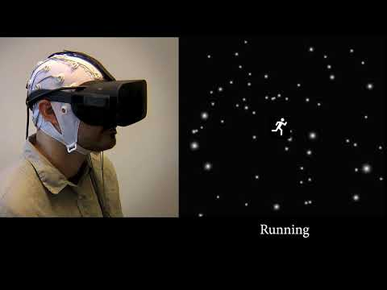
https://youtu.be/CvF2qN6sSxo

Slide 7
Starfield: UH vs Metachron
Differences between metchron starfield vs UH starfield demo
Metachron starfield environment is pretty straight forward, changes speed according to a given value.
UH starfield environment includes accelerating/decelerating control logic, filtering logic, logarithmic functions to generate dynamic values of speeding up and down. For example, upon detecting run run run the system accelerates stars faster faster and even faster.
WEB UI is a good and simple example of interfacing metachron’s starfield.
Notes:
This work considers WP5 lead by Helsinki.
Aim: to develop a solution for detecting psychophysiological states related to time perception and online converting the data to values that are used in manipulating the visual feedback presented in VR.
The work is geared towards demonstrating the usefulness of neuroadaptivity in modulating subjective time and related distortions

Slide 8
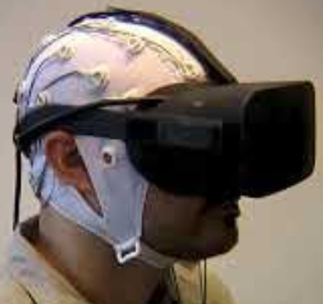
Openvibe
Unreal / Metachron
Training
Logic
Online prediction
Participant prompts
Starfield

Slide 9
Video
https://youtu.be/CvF2qN6sSxo

